Slide 1
CORPORATE ACTION – BUSINESS PROCESS FLOW
BA Monthly Meet
Presenter: Sourabh Jain
Designation: Business Analyst
Date:November 8, 2026

Slide 2
Agenda
1.
1.
Overview of Corporate Action
2.
Corporate Action – Business Process Flow
3.
Swift in Corporate Actions
4.
Risks involved in corporate action processing
CONFIDENTIAL© Copyright 2007 Wipro Technologies

Slide 3

Overview of Corporate Action
Corporate Actions Defined
Participants in Corporate Action
Categories of Corporate Action

Slide 4
What are Corporate Actions
Corporate Actions as defined by ECSDA:
“Corporate actions cover all the processes which arise from the announcement by an Issuer or his agent that an event affecting holders of the relevant security is to take place up until the moment when all effects of that event are complete”
Corporate actions are the announcements made by a company, which can affect the stakeholders of the company. All corporate actions are an event which has a material effect on the share price or a stakeholder’s right. Stakeholders are primarily shareholders, bondholders and mutual fund investor.
Most of the corporate actions are benefits given by a company to its stakeholders. These may be either monetary benefits like dividend, interest or non-monetary benefits like bonus, rights issue etc. There are other corporate actions like mergers, spin-offs, bond redemption etc affecting various stakeholders.
Corporate action processing is an important activity in determining the eligible stakeholder for applying corporate action benefits.
CONFIDENTIAL© Copyright 2007 Wipro Technologies

Slide 5
Participants in Corporate Action
Figure below depicts the main participants of corporate action and their relationships:
Issuer
(Originator of Corporate Action Event)
Information
Instruction
Information
Registrar/Agent
(Send information on to registered shareholders)
Custodian’s Nominee
Instruction
CSD
Broker/Dealer
Trade Instruction (if triggered by corporate action information)
Same firm
Custodian
(Processes information and instructions)
Information
Fund Manager
(Processes information and instructions; makes decision on corporate action
Instruction
Investor
Information
Instruction
(if not delegated to fund manager)
CONFIDENTIAL© Copyright 2007 Wipro Technologies

Slide 6
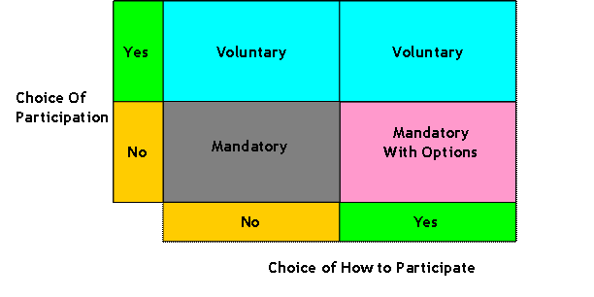
Categories of Corporate Action
Corporate actions can be divided into following broad categories:
CONFIDENTIAL© Copyright 2007 Wipro Technologies

Slide 7
Corporate Action Processing
High Level Business Process Flow

Slide 8
Corporate Action Business Process Flow
The business process flow diagram below, illustrates the high level flow of Corporate Action processing:
Stages in Corporate Action
Announcement Processing
Receive Event Data Feeds
Scrub Event Data Feeds
Access Event Information
Identification & Entitlement Processing
Identifying Shareholders
Calculation of Entitlement
Notification
Create Notification
Send Notification
Entitlement Reconciliation
Track Notification Status
Reconciliation & Settlement
Settlement Reconciliation
Settlement
CONFIDENTIAL© Copyright 2007 Wipro Technologies

Slide 9
Swift in Corporate Actions
Swift Corporate Action Standards (ISO 15022)
ISO 15022 CA Message Model
Swift CA Message Flow

Slide 10
Swift Corporate Action Standards (ISO 15022)
Swift messages are identified in a consistent manner. They all start with the literal "MT" which denotes Message Type. This is then followed by a 3 digit number.
Consider the following example which is a notification of a corporate action event (MT564):
  The first digit (5) represents the category. A category denotes messages that relate to particular financial instruments or services such Precious Metals, Syndications or Travelers Checks. The category denoted by 5 is Securities Markets.
  The second digit (6) represents a group of related parts in a transaction life cycle. The group indicated by 6 is Corporate Action Events.
  The third digit (4) is the type that denotes the specific message. The type represented by 4 is a Corporate Action Notification.
The ISO 15022 system enables financial institutions to construct and send messages about securities and corporate actions in a standardized, automated form and has become the de facto messaging standard for communicating securities and corporate-actions events and entitlements.
CONFIDENTIAL© Copyright 2007 Wipro Technologies

Slide 11
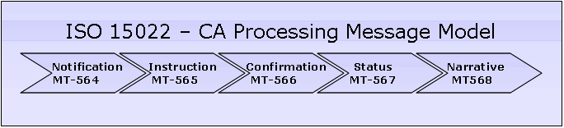
ISO 15022 Corporate Action Message Model
Following is the sequence of the corporate action messages exchanged between the Account Servicer and the Account Owner in case of a corporate action:
S.No. | Transaction Flow | Message Type
1 | Notification (MT-564) | Provide the Account Owner with information concerning forthcoming CA events
2 | Instruction (MT-565) | Provide the custodian with instructions on how the Account Owner wishes to proceed with a CA event
3 | Confirmation (MT-566) | Confirm to the Account Owner that securities/cash have been credited/debited to an account as the result of a CA event
4 | Status (MT-567) | Communicate to the Account Owner the status of an ongoing CA event or the status of an instruction sent by the Account Owner
5 | Narrative (MT-568) | Communicate to the Account Owner information pertaining to shareholders or provide complex instructions relating to a CA event
CONFIDENTIAL© Copyright 2007 Wipro Technologies

Slide 12
Swift Message Flow of a Mandatory CA Event
The diagram below shows the SWIFT message flow of a mandatory corporate action event with ‘Cash Dividend’ as an example:
Account Servicer
Preliminary Information
Complete Information
Entitlement Calculation
Receipt of new shares/cash
MT 564 Notification
MT 564 Notification
MT 564 Notification
MT 566 Confirmation of Account Activity
Account Holder
CONFIDENTIAL© Copyright 2007 Wipro Technologies

Slide 13
Risks involved in Corporate Action Processing
Types of risk in CA processing
  Direct risk of processing failures
  Direct cost of late payments
  Risk of sub-optimal trading decisions
  Indirect cost of ineffective corporate governance

Slide 14
Risks involved in CA Processing
In today’s corporate actions environment, it is common industry practice to allocate funds (~10% of operational budget) to cover losses associated with corporate action mistakes.
The direct risks to any individual firm involved in the corporate action processing chain can be very significant. Failure in handling a single, complex corporate action has the potential to result in a loss running into tens of millions of dollars. The risk is the highest for individual custodian firms because they safeguard large amounts of assets on behalf of many different investors, but fund management firms also face risks.
Corporate action risks are not limited to the back office. Failure to interpret corporate action information correctly may lead to sub-optimal trading decisions by brokerage and fund management firms for clients or for proprietary positions. The risk to firms’ front offices from sub-optimal trading decisions is estimated to be in the region of €6 billion - €8 billion globally.
CONFIDENTIAL© Copyright 2007 Wipro Technologies

Slide 15
Types of risks associated with CA Processing
Type of risk | Type of corporate action involved | Who bears the cost? | Zero-sum or net cost to the financial system?
Direct risk of processing failures | Mandatory with options; voluntary | Anybody in the corporate action chain (Liability depends on which market participant causes the failure) | In part zero-sum, but gains and losses are unevenly distributed; and extra transaction costs to unwind failure represent a cost to the system
Direct cost of late payments | Mainly mandatory | Investors (Interest forgone) | Mostly zero-sum (Interest forgone is gained by others)
Risk of sub-optimal trading decisions | All | Brokers or fund managers, Investors | Mostly zero-sum (Offsetting trading positions)
Indirect cost of ineffective corporate governance | Voluntary (mainly proxy voting) | Issuers, Investors, the system at large | Net cost to the system
CONFIDENTIAL© Copyright 2007 Wipro Technologies

Slide 16
Conclusion

Slide 17
Conclusion
Corporate actions total assets under custodians are growing at 20% per year which also reflect the growing business at investment management side. With this phenomenal growth it would be difficult to handle such large volumes in future for custodians as well as for investment managers who process the entitlement and payments to their customer, thus emphasizing the need to automate the corporate action processing system.
Voluntary corporate actions (or mandatory actions with options) - which are more complex and hence involve greater risk - represent only about 10 - 15% of all corporate actions taking place. Remaining 80 – 85% are of the mandatory type, which, by their nature, are relatively straightforward. Hence it will be prudent to leverage the advances in technology to automate events that can be, leaving more complex events to be tackled by experienced back-office users.
Recent developments like introduction of ISO 15022 based SWIFT messaging, Global Corporate Action hub solution by DTC, BASEL – II driven focus on operational risk have all contributed to this drive towards achieving STP.
CONFIDENTIAL© Copyright 2007 Wipro Technologies

Slide 18
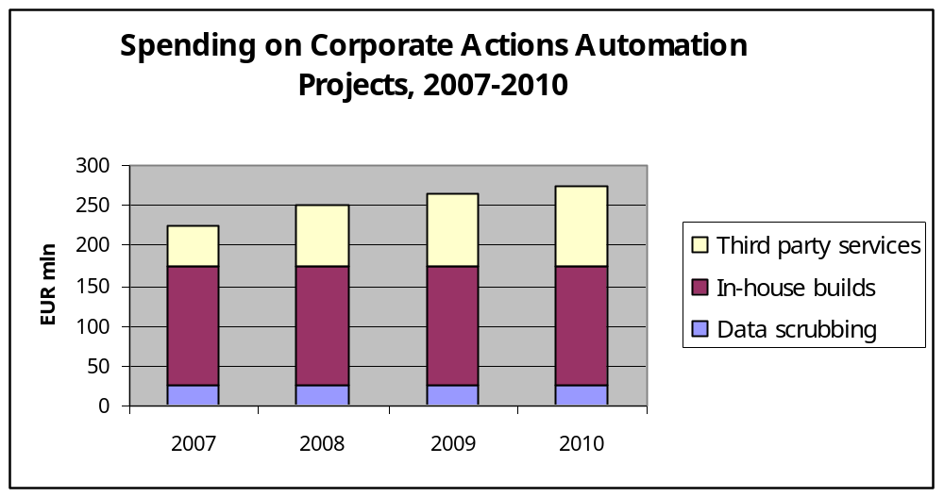
Conclusion (Contd..)
The market spending on Corporate Actions Solutions in 2006 was around 200 million Euros and as per the Celent estimations spending on Corporate Actions through third party vendors will grow by a compound interest of 20% in 2007-2010.
CONFIDENTIAL© Copyright 2007 Wipro Technologies

Slide 19
Thank You
sourabh.jain2@wipro.com
CONFIDENTIAL© Copyright 2007 Wipro Technologies

